Slide 1
Expense Tracker
Using Python

Slide 2
Introduction
An expense tracker is a tool that helps you keep track of your income and expenses. It can be used to create a budget, track your spending habits, and identify areas where you can save money.
Expense trackers typically provide a variety of features, such as:
The ability to categorize your expenses
The ability to set budgets
The ability to track your progress over time
The ability to generate reports

Slide 3
Working
Enter your expense name and expense : The first step to using an expense tracker is to enter your expense name and expenses. This can be done manually
Categorize your expenses: Once your expense name and expenses have been entered, you need to categorize them. This will help you to track your spending habits and identify areas where you can save money. Common expense categories include Housing, Food, Fun, Work, Misc .
Generate report : Once you categorize your expenses, program will generate report which contain Total spent, Budget Remaining, Budget per day.

Slide 4
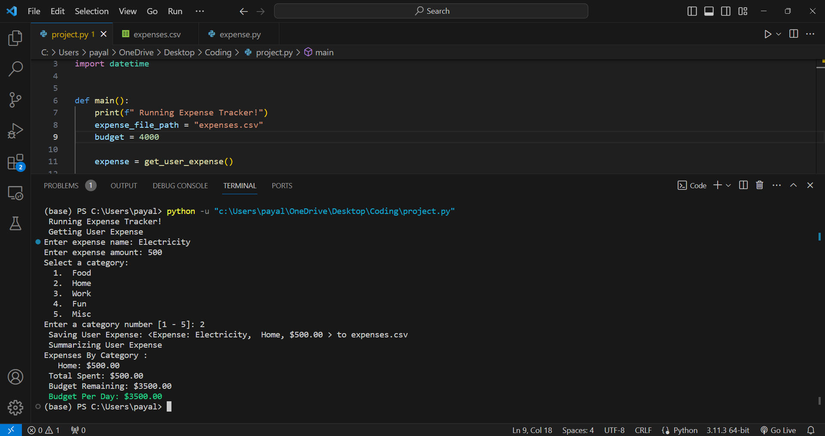
Output

Slide 5
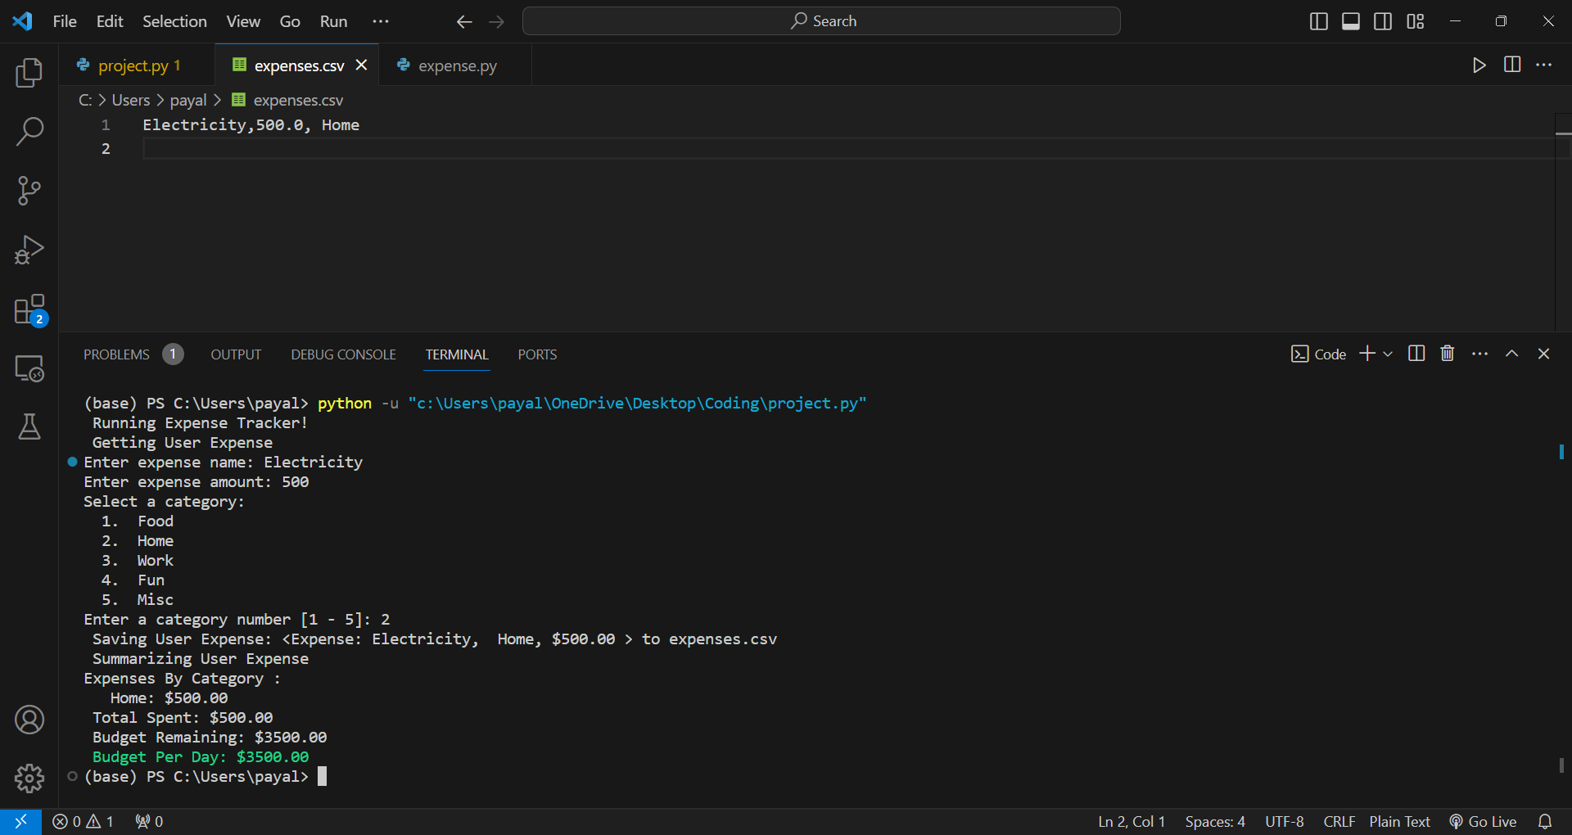
Storing expenses in CSV File :-

Slide 6
Uses of Expense Tracker
Tracking Income and Expenses: Expense trackers provide a centralized platform for tracking both income and expenses, providing a clear overview of your financial inflows and outflows. This allows you to understand where your money is coming from and going, which is crucial for making informed financial decisions.
Identifying Spending Patterns: Expense trackers can help you identify patterns in your spending behavior. You can analyze your expenses by category, date, or location to uncover areas where you might be overspending or areas where you can cut back.
Improving Financial Awareness: Overall, expense trackers promote financial awareness by providing a comprehensive picture of your financial situation. This awareness empowers you to make informed financial decisions, manage your finances effectively, and achieve your financial goals.

Slide 7
Advantages
Reduced Spending and Debt Management: Expense trackers can help you identify areas where you are overspending, allowing you to make adjustments to your budget and curb unnecessary expenses. This can lead to significant savings over time and help you manage debt more effectively.
Reach your financial goals: Expense trackers can help you to stay on track to reach your financial goals, such as saving for a down payment on a house or paying off debt.
Simplified Tax Preparation: Expense trackers can simplify tax preparation by providing organized records of your income and expenses. This can save you time and effort during tax season and ensure accurate tax filing.
Enhanced Financial Awareness: Expense trackers provide a clear and comprehensive overview of your income and expenses, enabling you to gain a deeper understanding of your financial situation. By tracking your spending habits, you can identify areas where your money is going, enabling you to make informed decisions about your finances.

Slide 8
Disadvantages
Data Entry: Manually entering expenses can be time-consuming and tedious, especially if you have a large number of transactions. Some expense trackers offer automatic data import from bank accounts, credit cards, and other financial institutions, but this feature may not be available for all institutions or may require additional setup.
Security Concerns: Storing sensitive financial data in an online expense tracker raises security concerns. Ensure the expense tracker you choose employs robust security measures, such as encryption and two-factor authentication, to protect your data.
Limited Scope: Expense trackers primarily focus on tracking income and expenses. They may not provide comprehensive financial planning tools or investment advice. Consult a financial advisor for more personalized financial guidance.

Slide 9
Future scope
Artificial Intelligence (AI) Integration: AI can revolutionize expense trackers by automating data entry, providing personalized spending insights, and predicting future expenses. AI-powered expense trackers can analyze spending patterns, identify areas for improvement, and suggest optimized budgeting strategies.
Real-time Spending Monitoring: Expense trackers can evolve into real-time spending monitors, providing instant feedback on transactions and budget compliance. This real-time feedback can help users make informed spending decisions in the moment, preventing overspending and staying within budget.
Predictive Analytics for Financial Planning: Expense trackers can leverage predictive analytics to forecast future expenses, helping users make informed financial decisions. This includes predicting upcoming expenses, estimating future income, and assessing potential financial risks
Cross-border Expense Management: Expense trackers can cater to the needs of global users, enabling seamless expense management across different currencies and tax jurisdictions. This is particularly important for businesses with international operations or individuals traveling frequently.

